Slide 1
Connective Tissue and Microscopic Muscle Anatomy
Subtitle

Slide 2
Quick Write
Fill in table distinguishing between the 3 muscle types:
Smooth | Skeletal | Cardiac

Slide 3
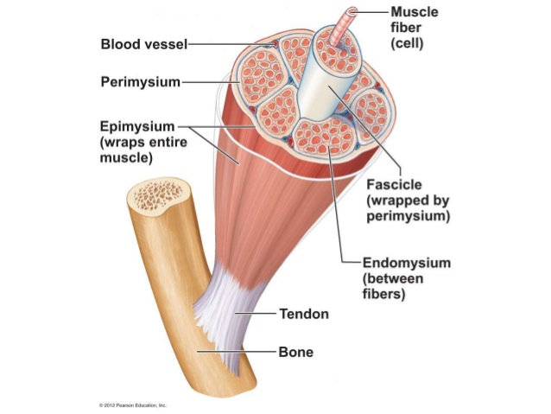
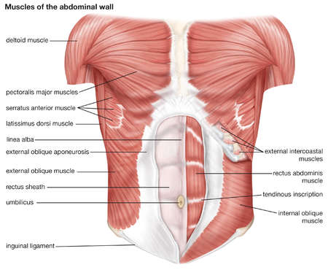
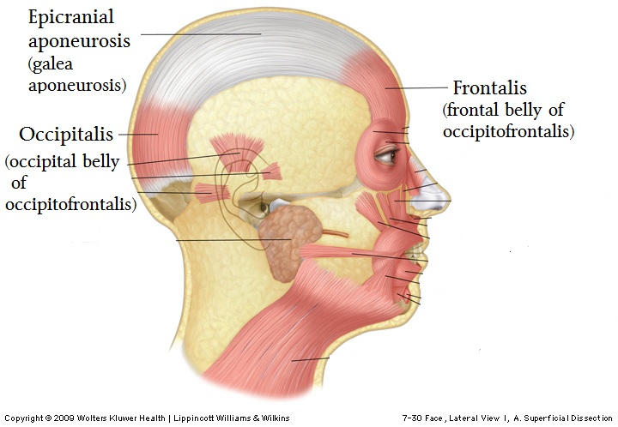
Connective Tissue Wrapping
Endomysium
Perimysium
Epimysium
Tendon
Aponeurosis

Slide 4
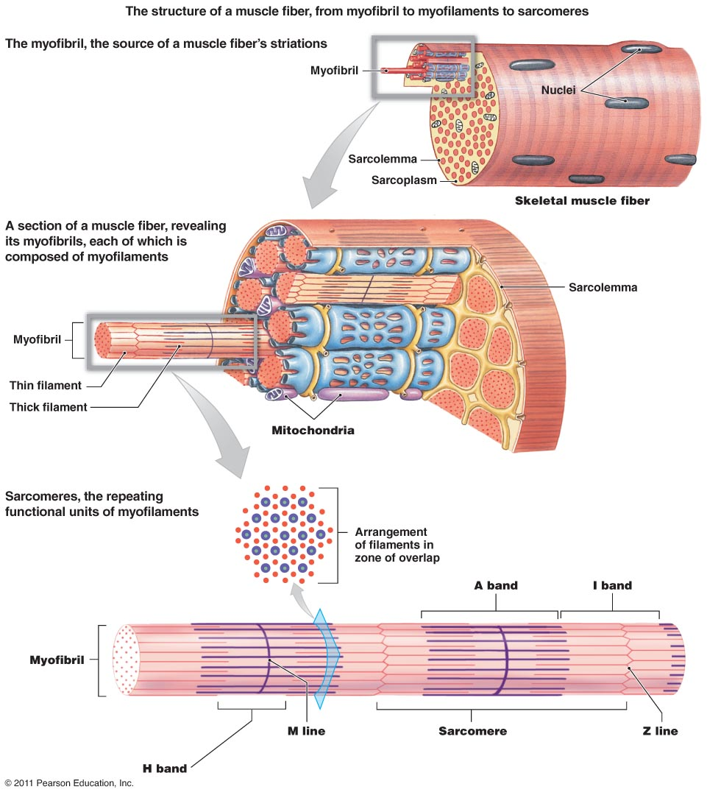
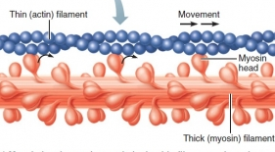
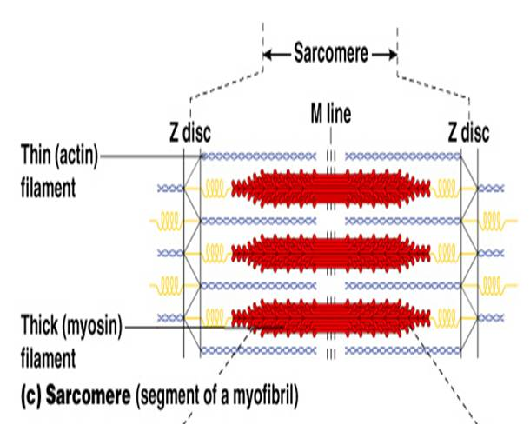
Sarcolemma
Sarcoplasmic Reticulum
Myofibril
Myofilaments – actin / myosin
I and A bands
Sarcomere
Z disc
Bare Zone
Myosin Heads

Slide 5
Review – Student Review Make a sarcomere
Label:
Z disc
H zone
A band
I band
Actin
Myosin

