Slide 1
TAPING

Slide 2
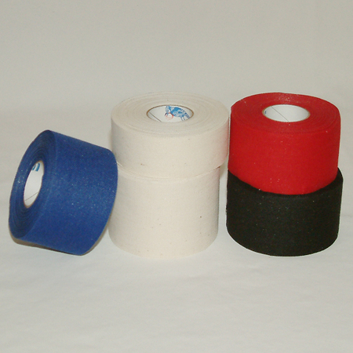
Taping
Adhesive/Non-elastic
WHY?
Sizes
Variety of techniques

Slide 3
Goal of effective taping:
Reduce Swelling
Unnecessary stress
Protection
Decrease Pain
Optimal healing
Restrict ROM – range of motion

Slide 4
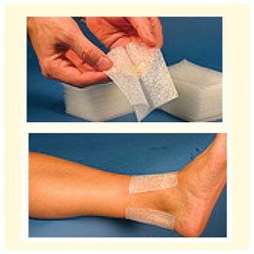
Preparing to Tape
Properly prepare and protect the skin
Clean
Shave
Foam/lace pads
Pre-wrap

Slide 5
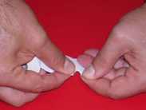
Taping Tips:
How to tear
If it folds – move to a new location
Apply individual tape strips
Overlap by half their width
Let the tape guide you
Patience

Slide 6
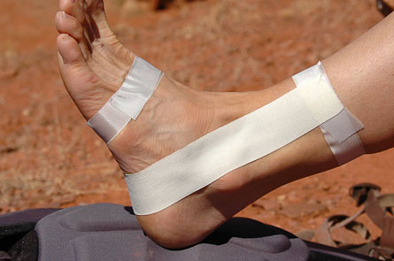
Taping Terminology
Anchors
Stirrups
Horseshoe

Slide 7
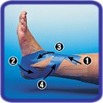
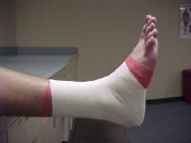
Taping Terminology
Heel lock
“Lace up the tape”
Closure strips

Slide 8
Post-taping Considerations
Premature participation
ROM
Circulation
Allergies
Undue dependency
Tendons, muscles
Ice - no

Slide 9
Taping Helpful Hints
Joint – stabilized position
Muscle – contraction
Overlap at least ½
Avoid continuous taping
Keep roll in hand
Smooth and mold tape
Follow natural contour of skin
Anchor and lock strips
Do not apply if skin is hot/cold
Check circulation and comfort

